Slide 1
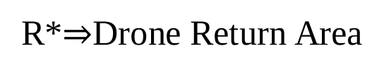
START
FINISH
R*
GROUND
FLOOR
PIT Area
(Outdoor)
VIP AREA
PILOT WAITING AREA
RACING PILOT STATION
1ST
FLOOR
GYM
R*$⇒$Drone Return Area
Notes:
R$⇒$Drone Return Area

Slide 2
Holding area
CENTEXS E-sports AREA
Notes:
Holding area

Slide 3

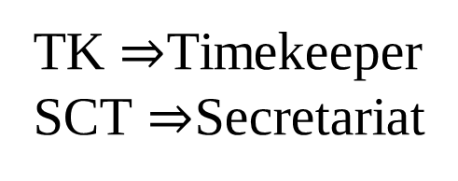
Holding area (outdoor)
SCT
PC1
TK
PC2
TK $⇒$Timekeeper
SCT $⇒$Secretariat
Notes:
TK $⇒$Timekeeper
SCT $⇒$Secretariat

